Slide 1





Probing Quark Gluon Plasma using B Mesons
Jean Luo, Simao Costa, Henrique Legoinha, Nuno Leonardo
06/09/2022

Slide 2
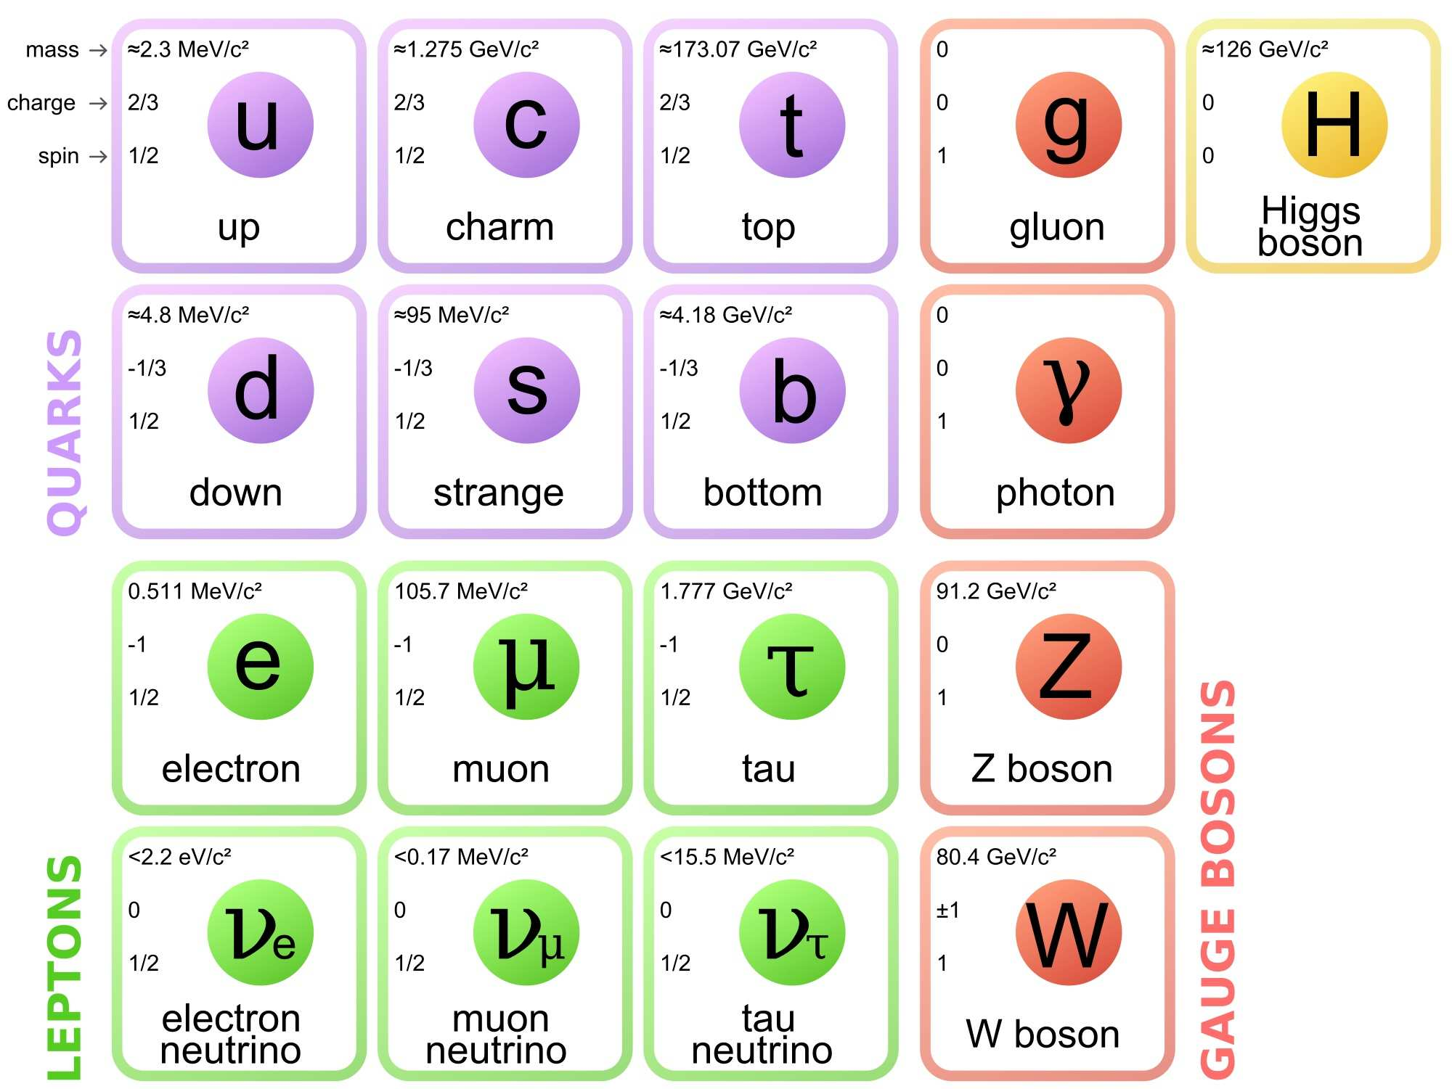
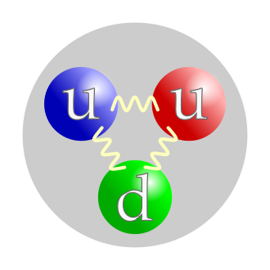
The Standard Model and Hadrons
Describe known elementary particles and the fundamental forces governing them
Quarks are normally bound by gluons in the form of hadrons, like baryons (e.g. proton (uud))
Table of elementary particles of the Standard model (source: wikipedia)
Simple illustration of the structure of a proton (source: wikipedia)

Slide 3
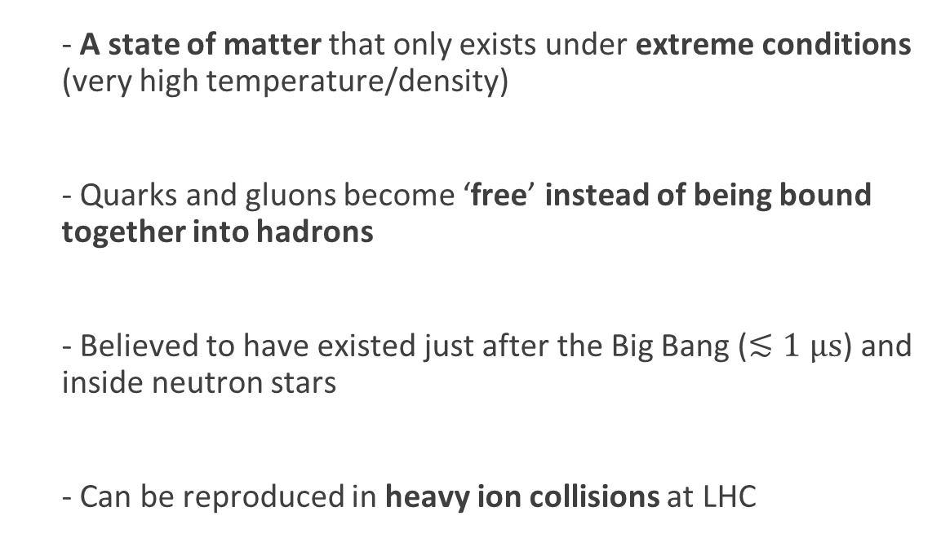
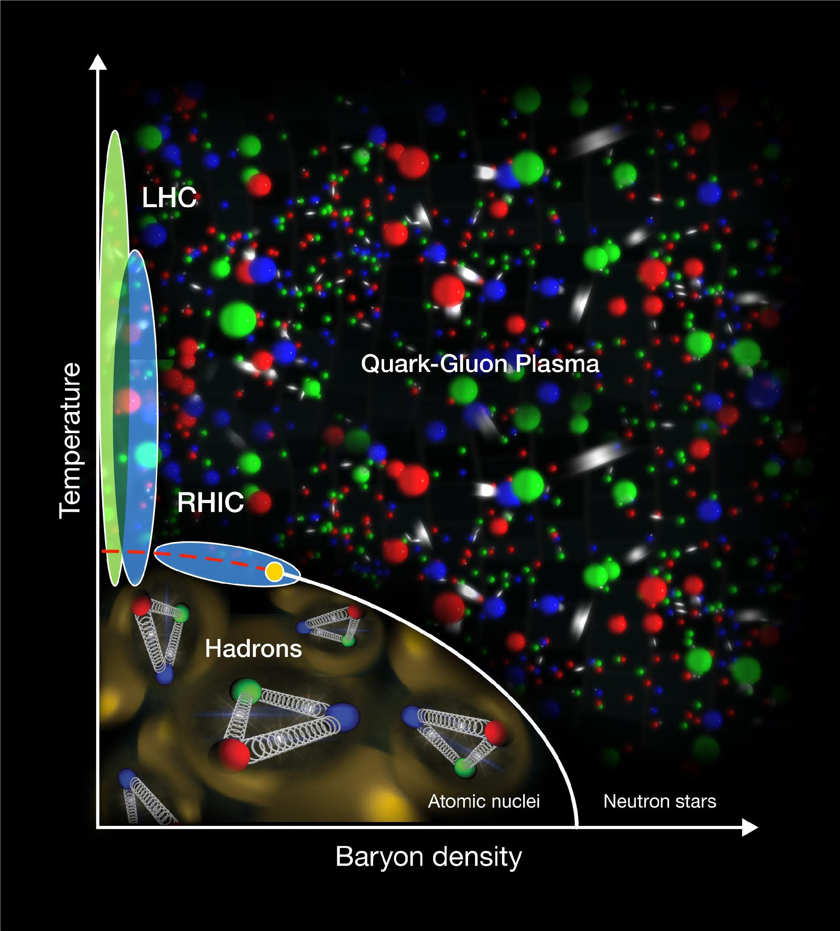
Quark-Gluon Plasma (QGP)
Phase diagram of QGP (Source: CEA)

Slide 4
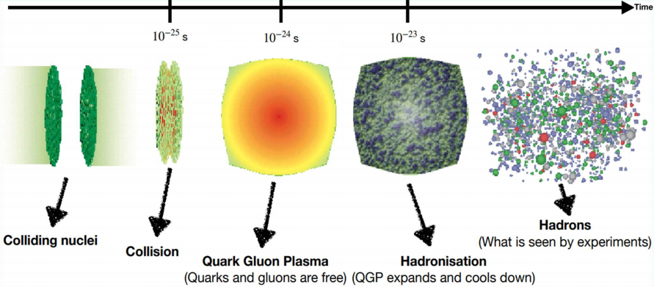
Heavy ion collisions
Aim to study the hadronisation process of quarks & the effect of presence of QGP on the process

Slide 5
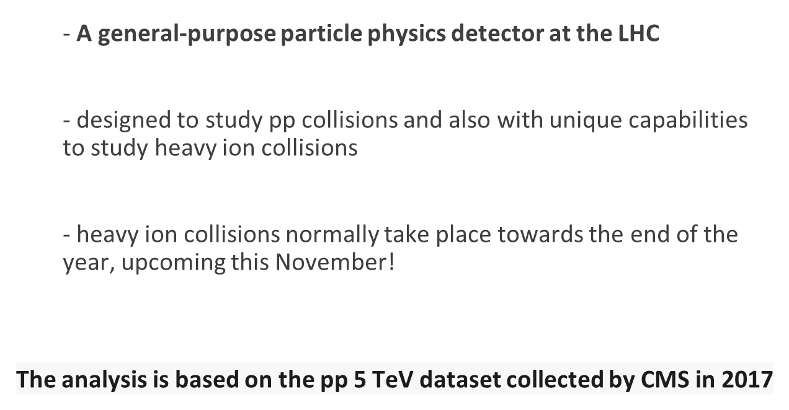
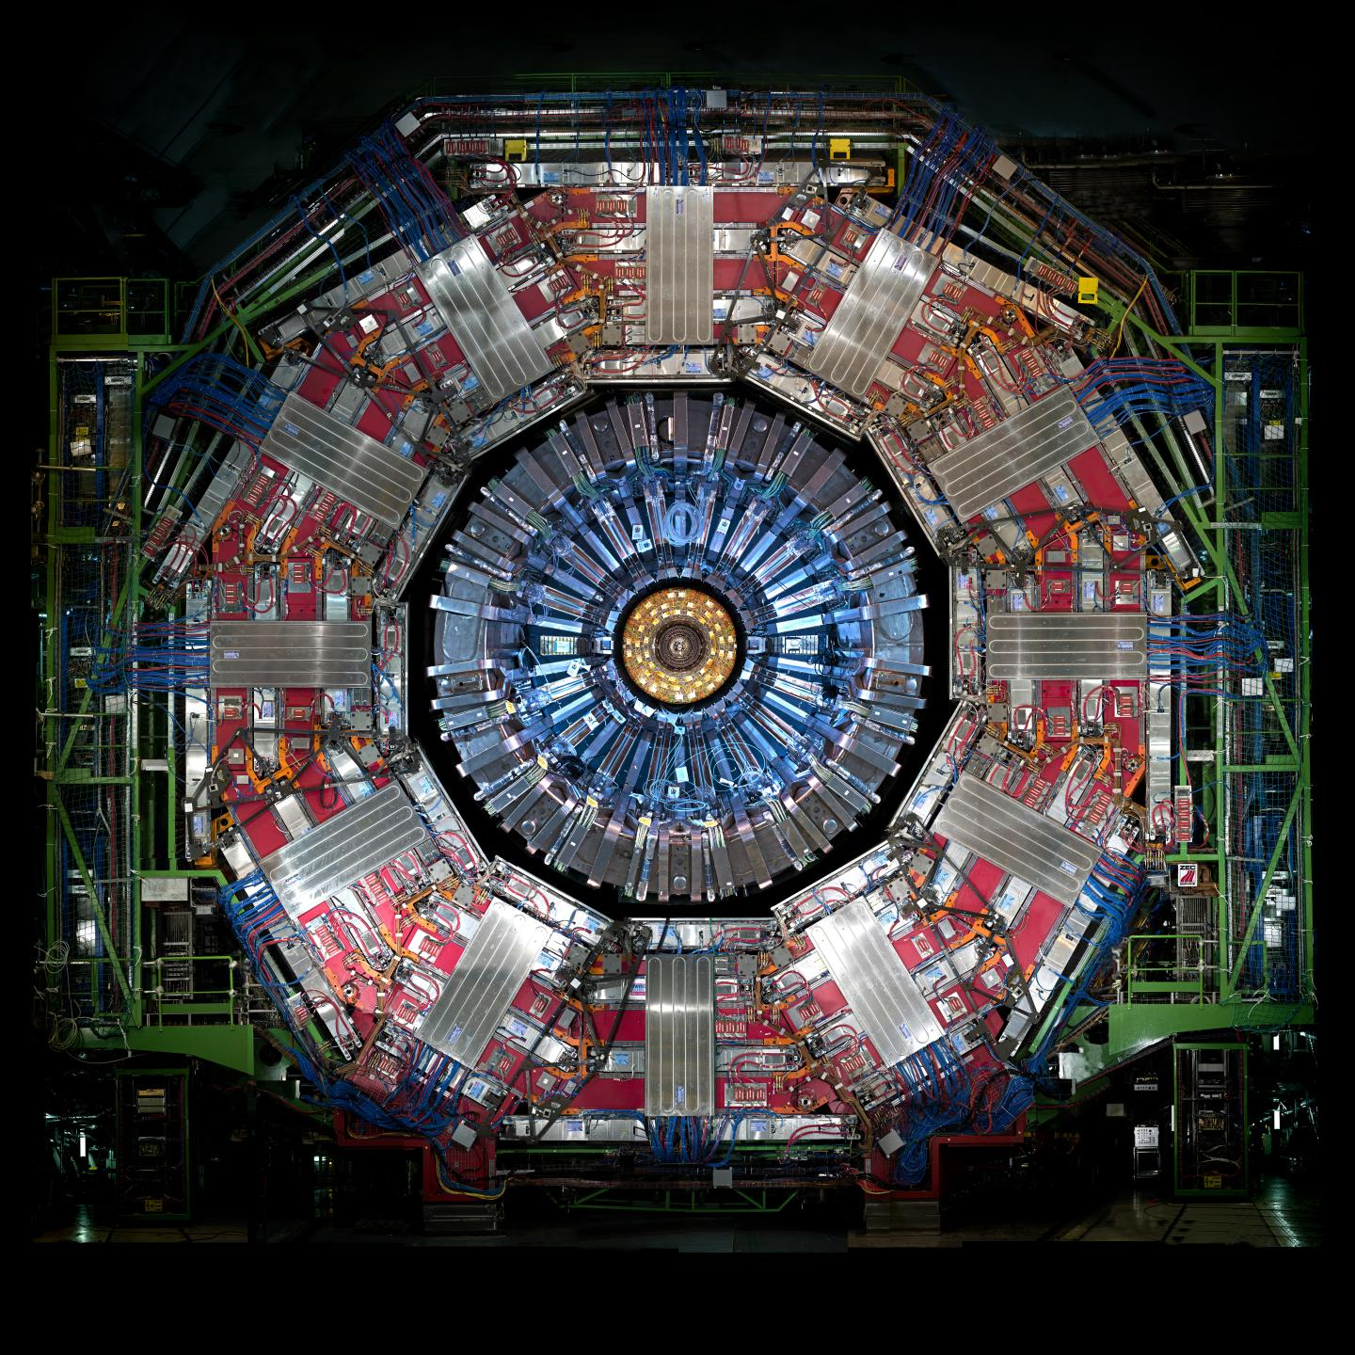
Compact Muon Solenoid (CMS)
should have just taken place

Slide 6
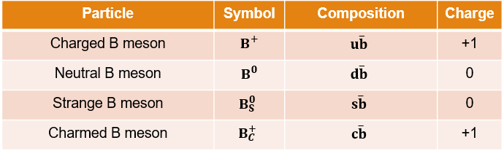
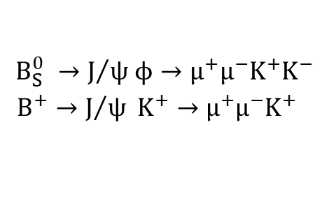
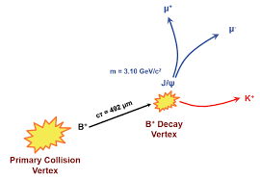
B mesons, probe of QGP
Meson: Hadrons made of a quark and an antiquark
B mesons formed from hadronisation of b quarks
We explore the following B⁰_{s} and B⁺ decay channels:
Detect and measure particles at the end of the decay chain
Why B mesons?
Longer life time 🡪 larger displacement 🡪 can be distinguished
Massive enough 🡪 Negligible thermal production

Slide 7
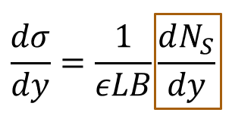
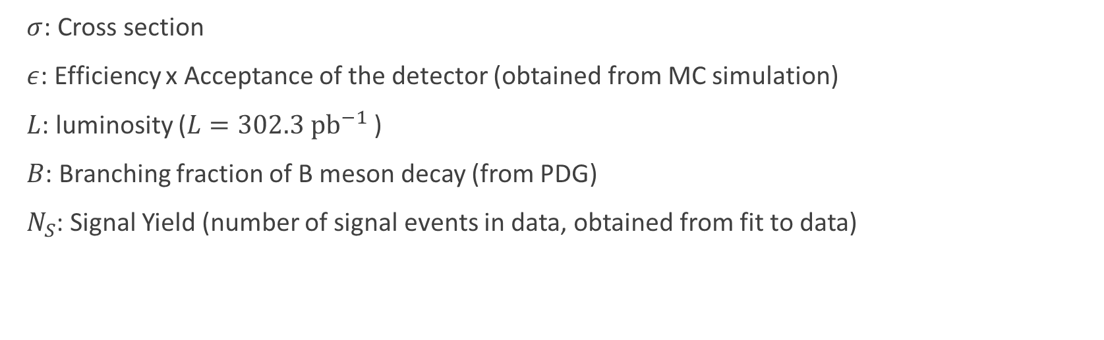
Differential Cross Section

Slide 8
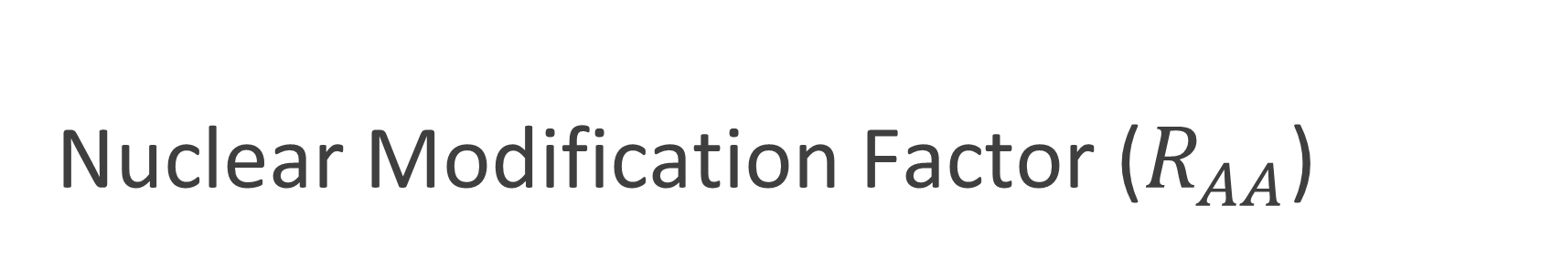
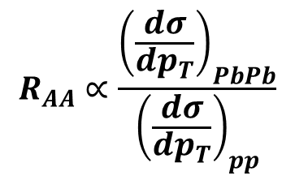
PbPb: lead-lead collision 🡪 producing QGP
pp: proton-proton collision 🡪 not producing QGP
Compare them

Slide 9
Fitting the data: B⁰_{S}
(Fit using Extended Unbinned Maximum Likelihood method)

Slide 10
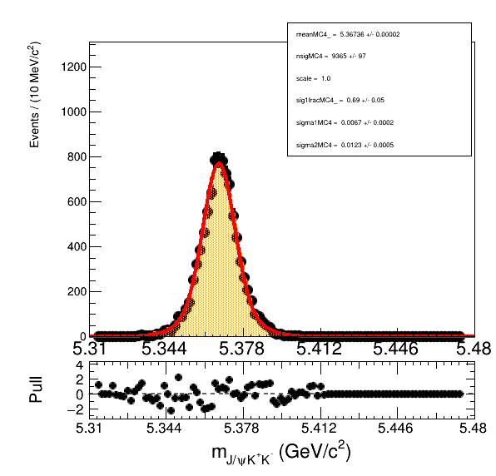
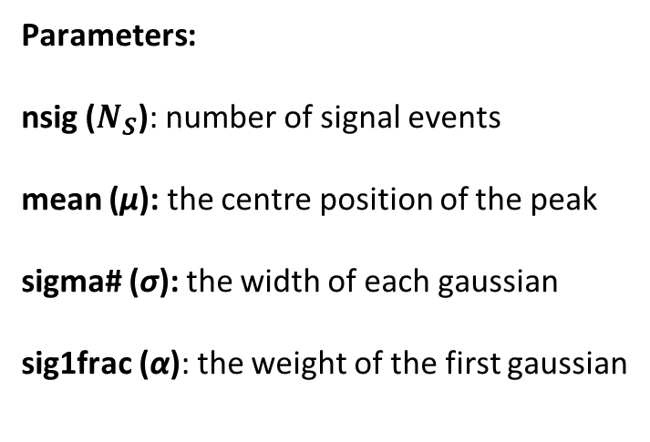
Fit to Monte Carlo (MC)
Parameters
Double gaussian signal
Fitting procedure:
Fit signal-only MC sample to extract signal shape parameters
Fit the data sample constraining the signal shape parameters from MC (next slide)

Slide 11
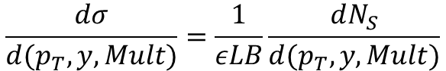
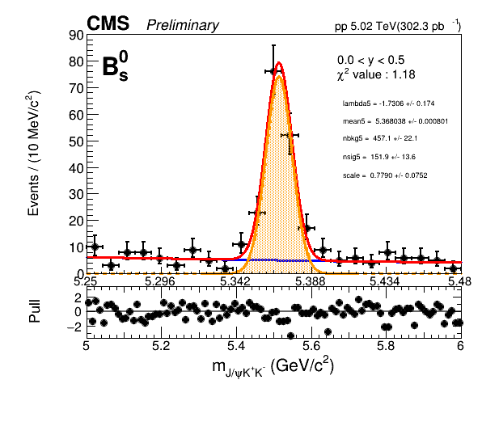
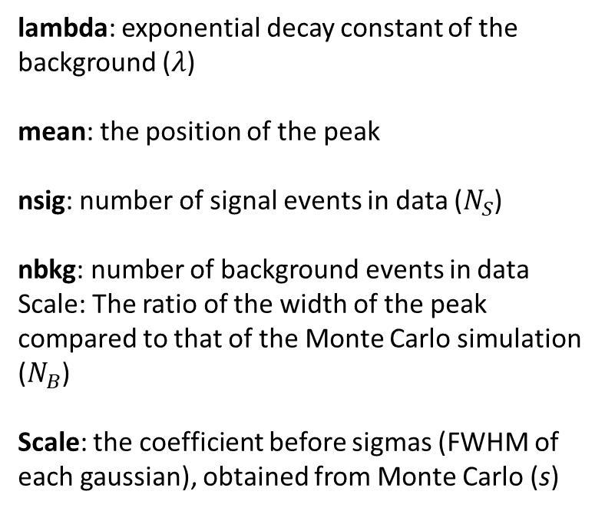
Fit to data
Signal + Background
(μ)
Signal
Background
Zoomed on the peak
scale: the factor before the width of the peak (s)
𝛘² Value (normalised): Quality of the fit test result
Fitting range (5-6 GeV)

Slide 12
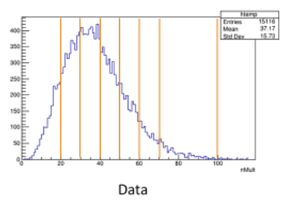
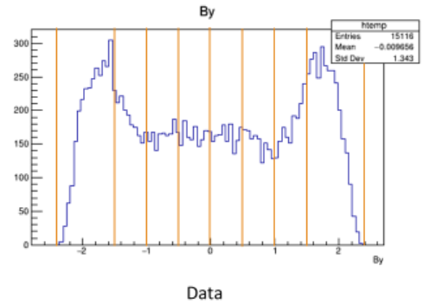
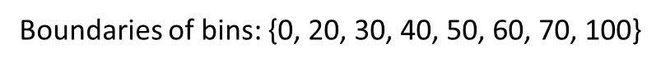
Binning of Rapidity and Multiplicity
Rapidity
Multiplicity
Next, we perform the fits in each of these bins

Slide 13

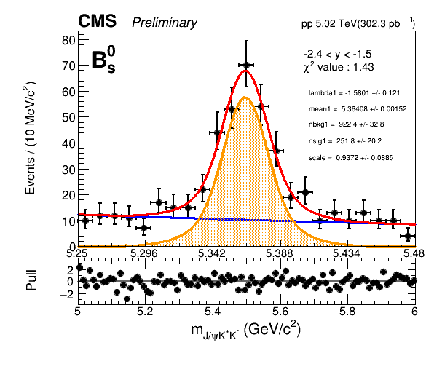
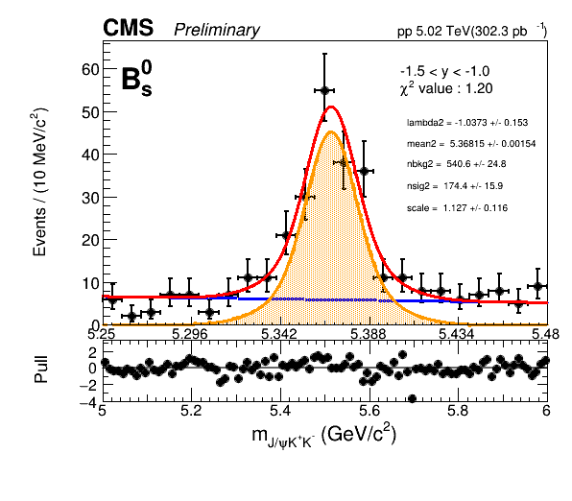
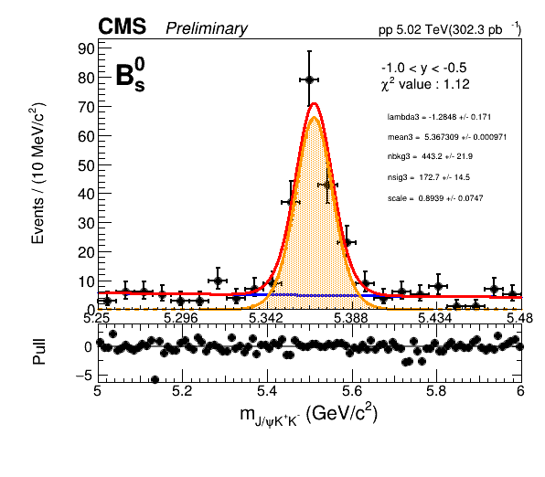
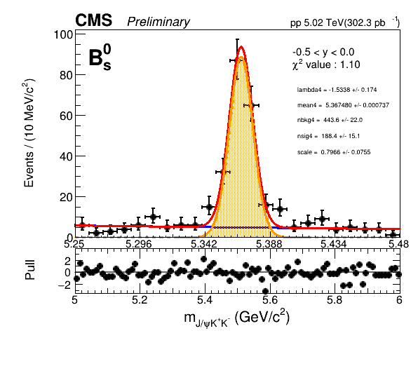
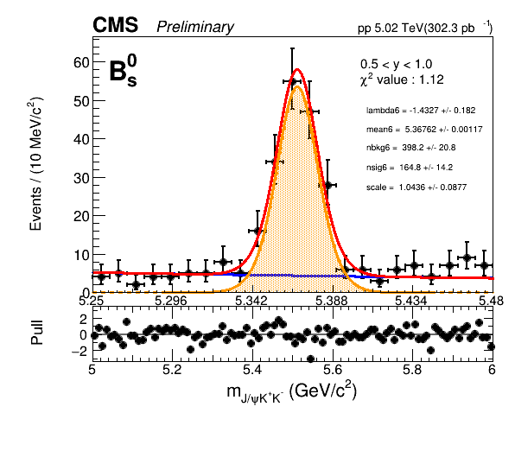
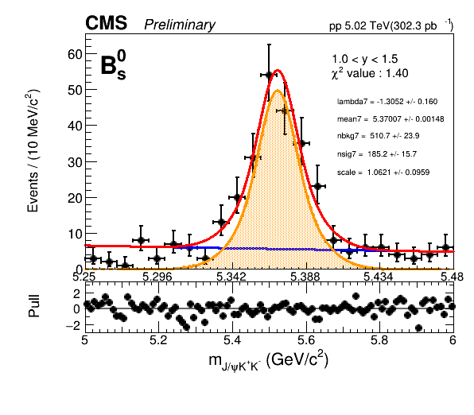
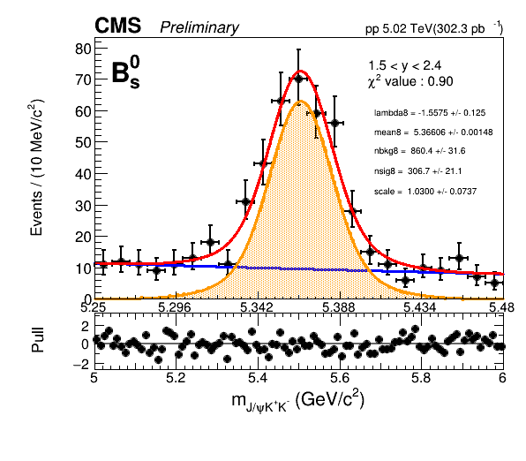

Slide 14

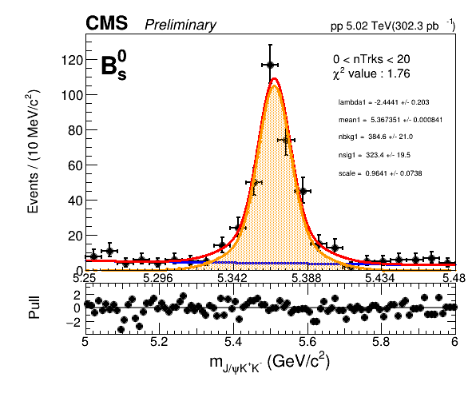
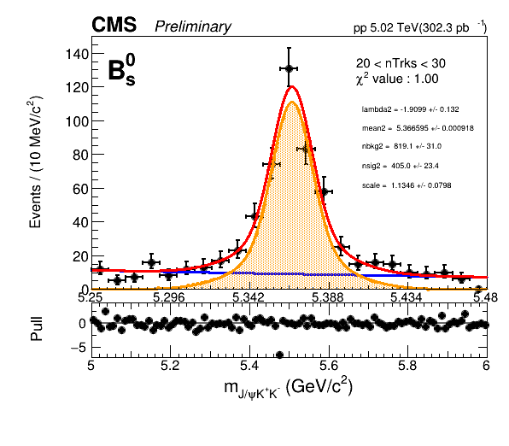
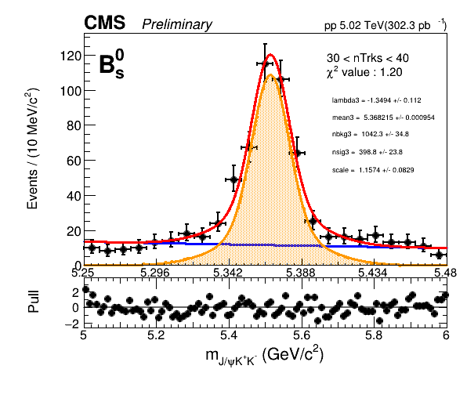
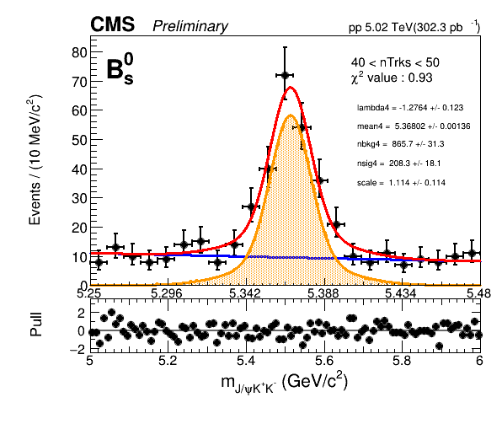
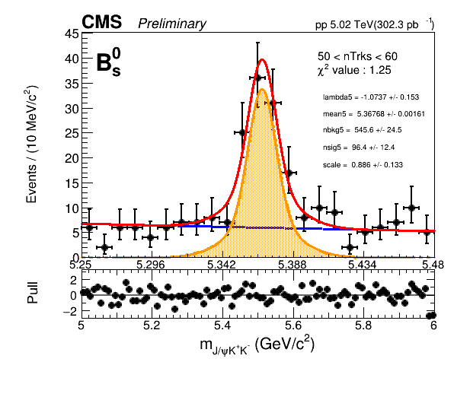
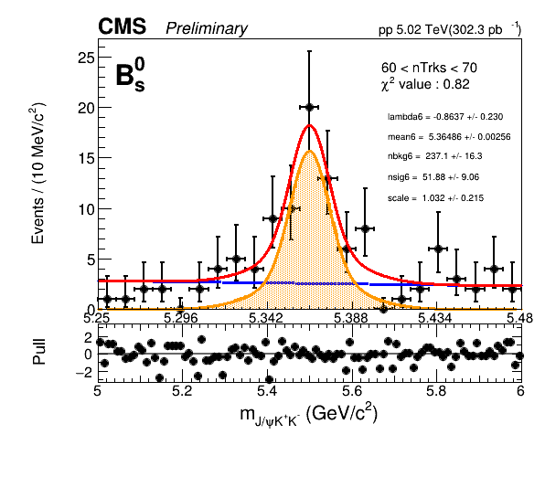
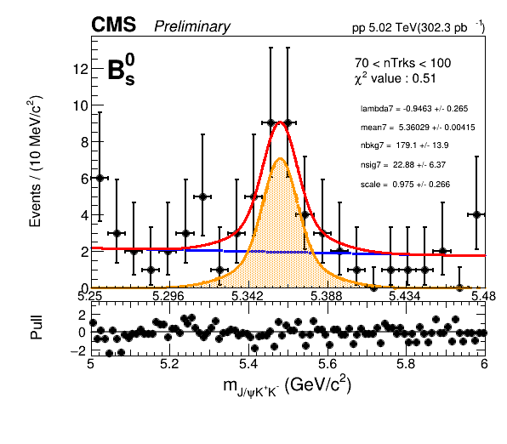

Slide 15
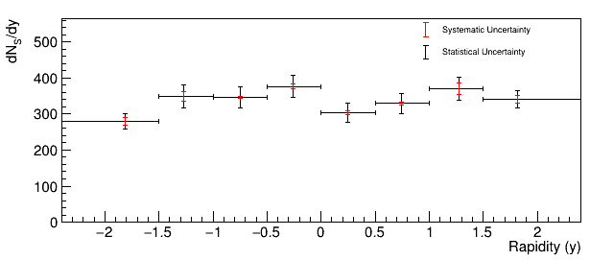
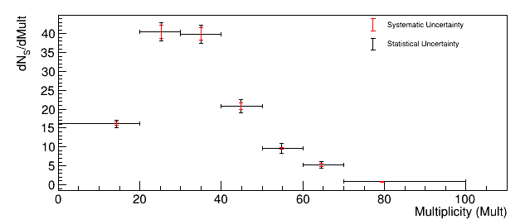
Differential results

Slide 16
Fitting the data: B⁺
(Fit using Extended Unbinned Maximum Likelihood method)

Slide 17

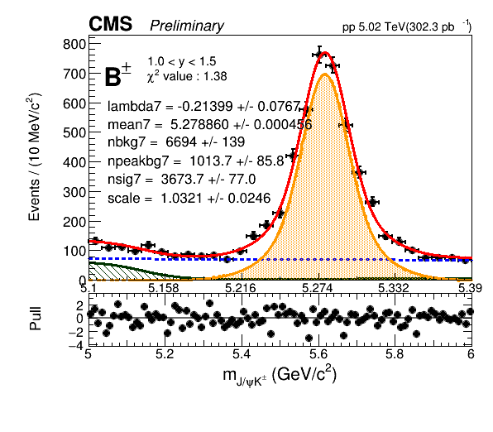
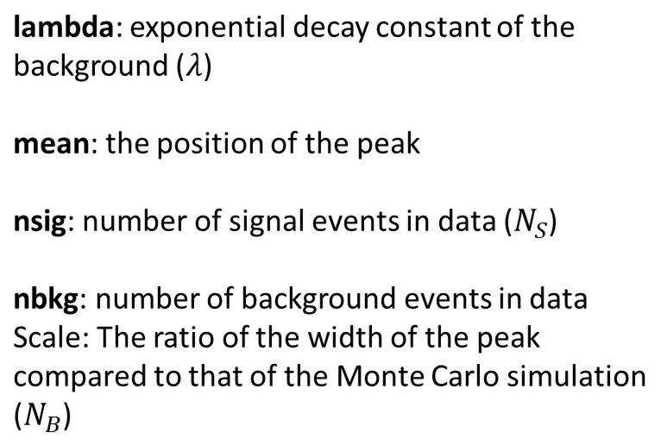
Signal + Background
Signal
Combinatorial Background
Partially reconstructed decays
Npeakbg: number of events in partially reconstructed decays
𝛘² Value: Quality of the fit test result

Slide 18

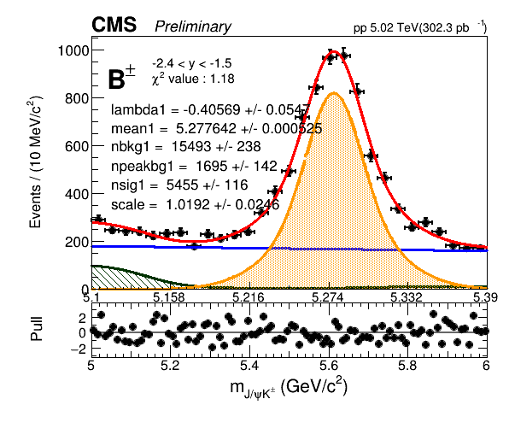
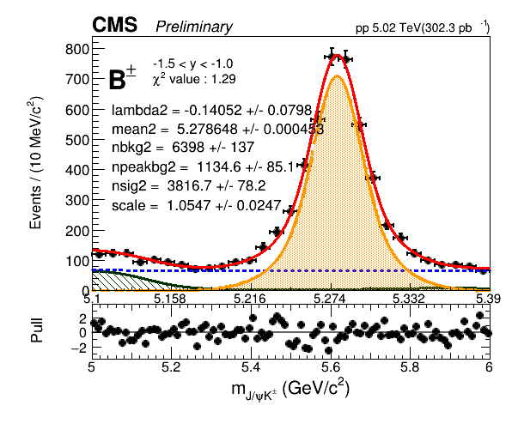
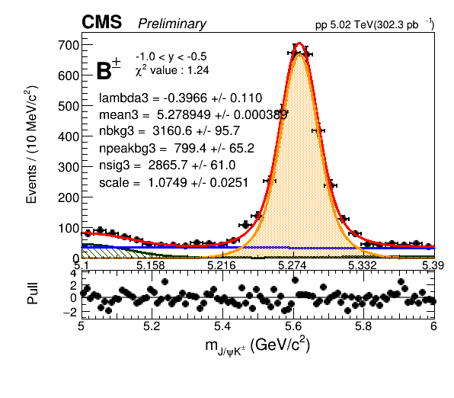
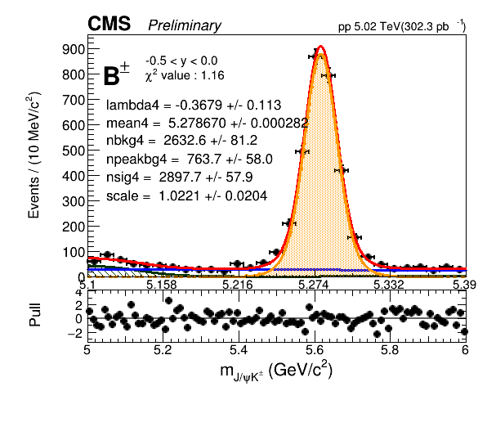
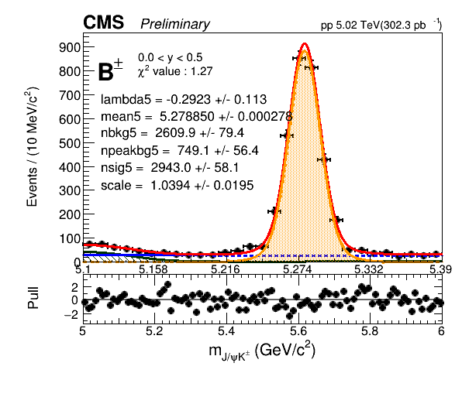
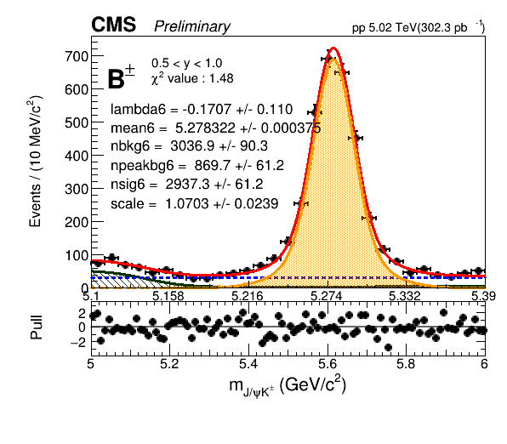
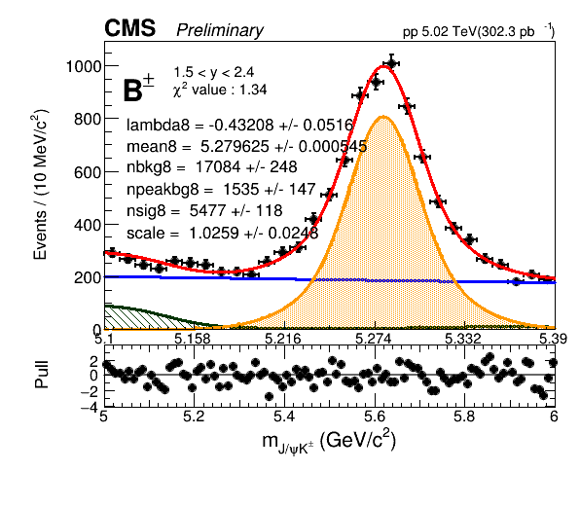

Slide 19

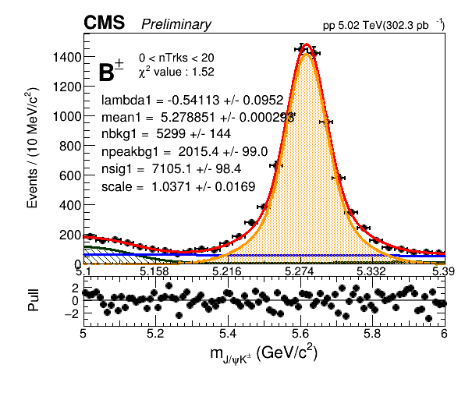
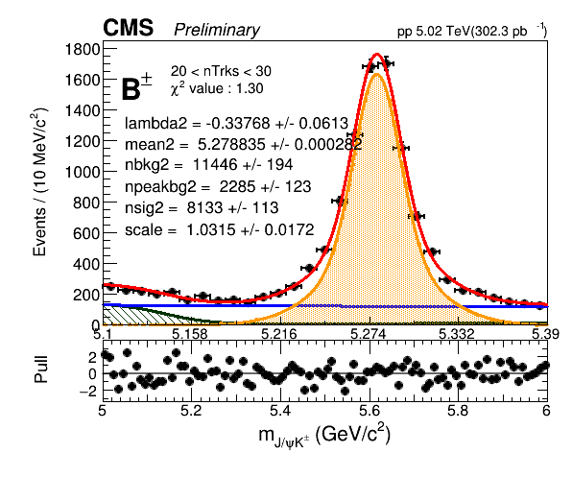
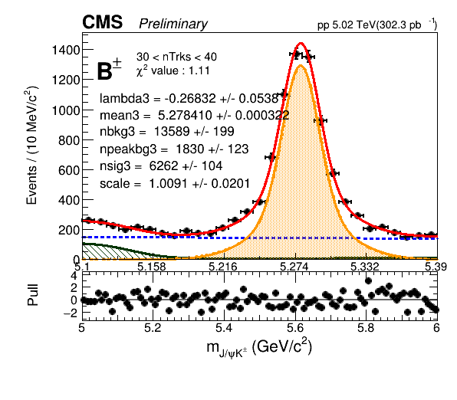





Slide 20


Differential results
pp->B+X production cross section versus B mesons rapidity and event multiplicity

Slide 21
Systematic uncertainties

Slide 22

Systematic variations
Nominal signal model: Double Gaussian
Variations:
- Triple Gaussian
- Fixed mean
- CB + Gaussian
- Double CB (for testing)
Signal
Background

Slide 23



Background modeling variations
Linear
Second Order Polynomial
Mass range
(Examples from rapidity fits)

Slide 24




Signal modeling variations
Crystal Ball + Gaussian
Double Crystal Ball
Triple Gaussian
Fixed mean
(Examples from rapidity fits)

Slide 25






Systematics
Rapidity
Multiplicity

Slide 26
Quality of fits

Slide 27




Signal Variations Fit Quality test
Rapidity
Multiplicity

Slide 28




Background Variations Fit Quality test
Rapidity
Multiplicity

Slide 29
Stability analysis

Slide 30


Mass Resolution (versus Rapidity)
The detector resolution is optimal in the central region (small |y|) and degrades towards the forward region (large |y|), as expected

Slide 31
Cross section Results

Slide 32





Computation of cross section
Efficiencies
Raw yields

Slide 33




Cross section
Rapidity
Multiplicity

Slide 34
Summary

Slide 35
Summary
We have analysed the pp data collected by CMS at 5 TeV
We have measured the differential production cross sections for B⁰_{s} and B⁺ mesons
As function of meson (y) and collision (mult) observables that had not been studied before
Including detailed study of systematic uncertainties
The work also involved
Implementing and carrying out a large number (~600) of fits to MC and data
Verify their quality, via chi2 and pull calculations
Verify parameter and resolution stability across bins

Slide 36

Next steps
Finalize measurement of the cross sections for B⁰_{s} and B⁺ mesons
Compare our results with the theory prediction
Use obtained results to determine:
Ratio of cross sections in pp collisions B⁰_{s}/B⁺ (quark hadronisation process)
Ratio of cross sections in pp and PbPb collisions, (properties of QGP)

Slide 37
Thank you for your attention!

Slide 38
Backup

Slide 39


Unbinned Extended Maximum likelihood

Slide 40



Rapidity
Multiplicity

Slide 41


Background systematics
Rapidity
Multiplicity

Slide 42


Signal Systematics
Rapidity
Multiplicity

Slide 43


Fit Quality test (Rapidity)

Slide 44


Fit Quality test (Multiplicity)

Slide 45


Resolution scale
Rapidity
Multiplicity

Slide 46


Resolution scale (Rapidity)

Slide 47


Resolution scale (Multiplicity)

Slide 48


Mass Resolution (Multiplicity)

Slide 49


Mass Resolution
Rapidity
Multiplicity

Slide 50


w

Slide 51
Summary
y: 64 data fits + 40 MC fits
mult: 56 data fits + 36 MC fits
pt: 56 data fits + 36 MC fits
y: 64 data fits + 40 MC fits
mult: 56 data fits + 36 MC fits
pt: 56 data fits + 36 MC fits
Gave 12 talks:
6 in CMS Spectra and Heavy Flavour meeting: 21st July. 28th July, 4th August, 18th August, 25th August, 1st September
6 in LIP CMS meetings: 27th July, 3rd August, 10th August, 17th August, 23rd August, 31th August

